Slide 1
WORKING WITH ELDERLY FEMALE VICTIMS THAT HAVE SUFFERED FROM VIOLENCE FROM THEIR RELATIVES
_____________________________________________________________________
www.marta.lv
29.11.2018.
Riga

Slide 2
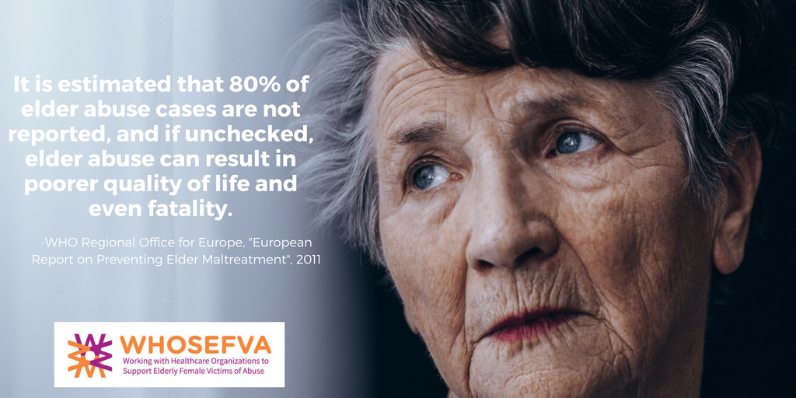

Slide 3
An EU financed project Working with Healthcare Organizations to Support Elderly Female Victims of Abuse/ #WHOSEFVA (2016 -2018).
In cooperation with partner organizations in Estonia, Finland, Greece, Austria and the United Kingdom.
The primary task:
To increase the capacity of organizations working with domestic violence issues, so that they may better represent the interests and rights of elderly women in health care and health care policy who have been subject to violence, thereby helping to meet EU requirements.
In order to do so:
hold focus group interviews with women in Riga and in other regions of Latvia;
hold a discussion workshop with clinicians - doctors, nurses and home care specialists;
hold training seminars for healthcare professionals

Slide 5
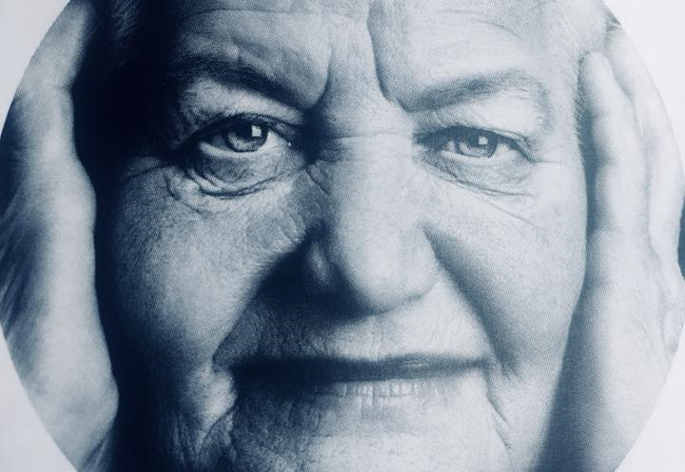
hold focus group interviews with women between the ages of 55 and 91 who have experienced violence or witnessed violence

Slide 6
When elderly women face violence, most often it’s from their partner or son.
Women do not deny the professional help of specialists, but also report that they usually seek help from friends and relatives, because they don't believe social services can help them.
Women lack trust in the work done by the police.
A significant obstacle in all this is the attitude of those closest to them and the society, which mostly justifies the actions of perpetrators.
*but he’s such a good person *but your husband is such a respectable man
Women acknowledge that they have been completely alone in their struggle to end an abusive relationship.
Participants in the interviews highlight material security and financial independence as crucial
*tell young girls that they must learn a trade
Even minimal income / guaranteed financial resources (pension) creates a sense of safety
*We feel safer now We can finally say what we think, in comparison to what works, we can say what we think, no one can take our pension from us.
Generally, women don’t see the family doctor to be the person to turn for help in cases of violence.

Slide 7
When faced with violence, women don’t seek help from the social services or the police, but visit a doctor instead and seek health care.
The family doctor can recognize signs of violence in the event a person visits them regarding a different issue.
Therefore:
Significant involvement of health care providers in the prevention of violence is necessary in the recognition and appropriate redirection of social assistance.
Because:
A clinician recognizes violence, but there is no system in place that allows immediate redirection of the victim to social assistance and crisis intervention services.
Suggestions:
A 24/7 on-duty social worker;
Access to shelters;
Immediate help and crisis intervention.

Slide 8
Recommendations
Ratification of the Istanbul convention;
Functional funding towards a crisis intervention service;
The provision of a safe asylum:
The protection of data:
A community coordinated response to domestic violence.

Slide 9
Matīsa iela 49-3, Rīga
www.marta.lv
67378539
@CentrsMARTA
Co financed by the EU Programme "Rights, equality and citizenship”, Agreement No. JUST/2015/RDAP/AG/VICT/9320

